Slide 1

Analysis of Traffic Data for the City of Los Angeles
Cai Chen, Moyan Zhou, Yifan Ruan

Slide 2
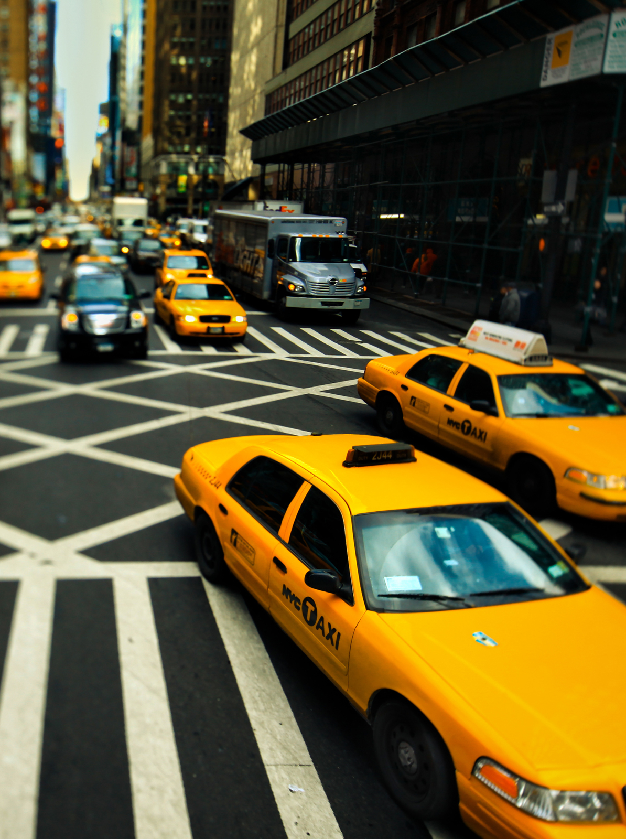
Outline
Motivation
Dataset
Methodology
LA Uber ride pick up distribution
5. Analysis of LA areas
6. Analysis of Freeways
7. Conclusion

Slide 3
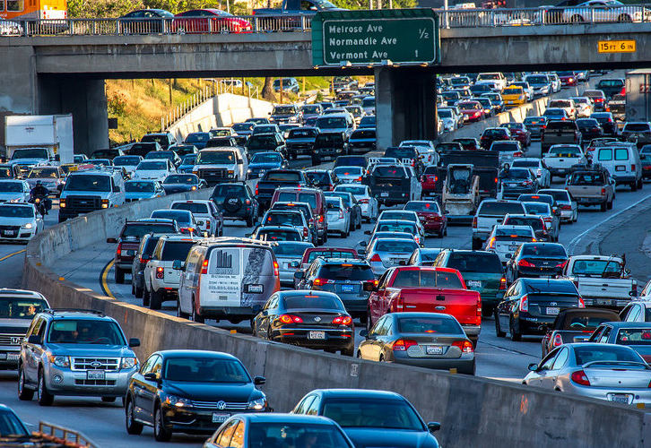
Motivation
Increasing demand on ride-hailing service
LA is one of the world’s most congested city
3. For the sake of driver’s benefits,
— where & when to pick up more guests?
— how to save time from traffic congestion?

Slide 4
Dataset
Uber movement in Los Angeles
Data over last year reported hourly
Include hour of day, destination, source and travel times
Traffic incidents in Los Angeles
Data over last year reported monthly
Include freeway direction, date occurred, area name, location, crime description
California freeways
Data over last year reported hourly
Include time, flow, speed

Slide 5
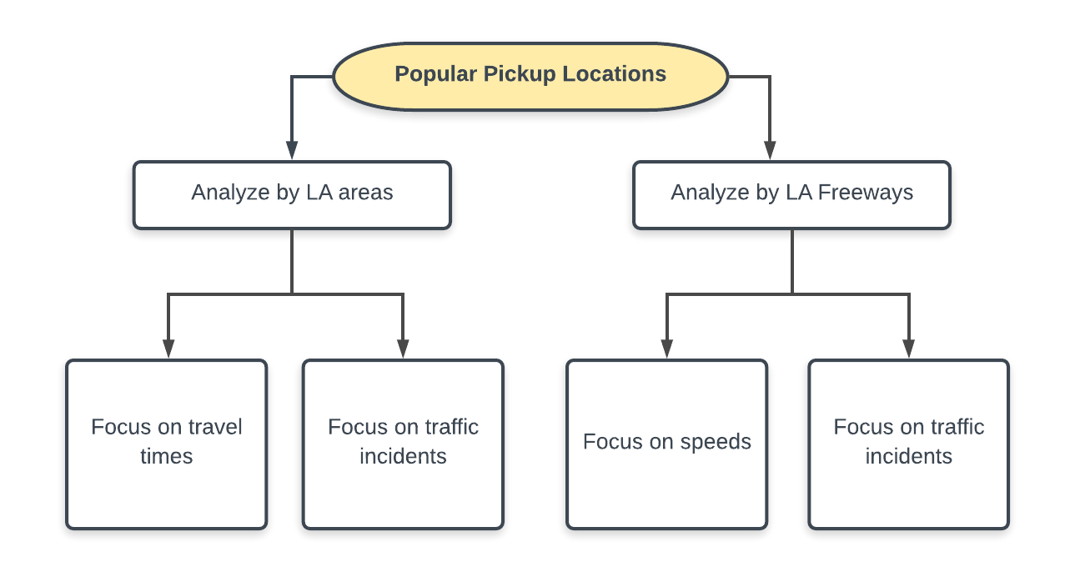
Methodology

Slide 6
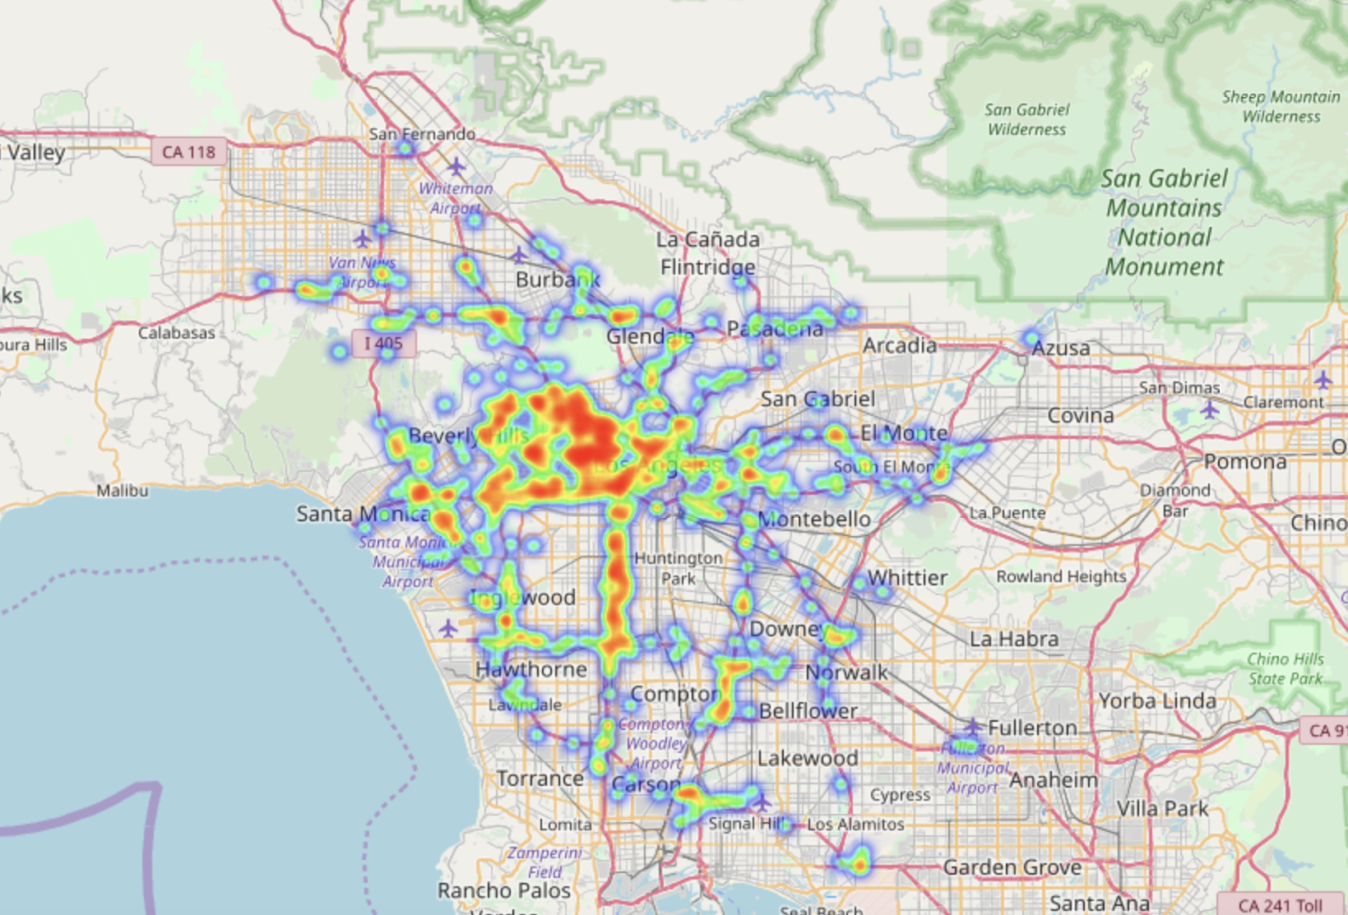
LA Uber ride pick up distribution
The heat map generated
has two possible interpretations:
Hot spots analyzing by areas
Busiest freeways with more pickups
6

Slide 7
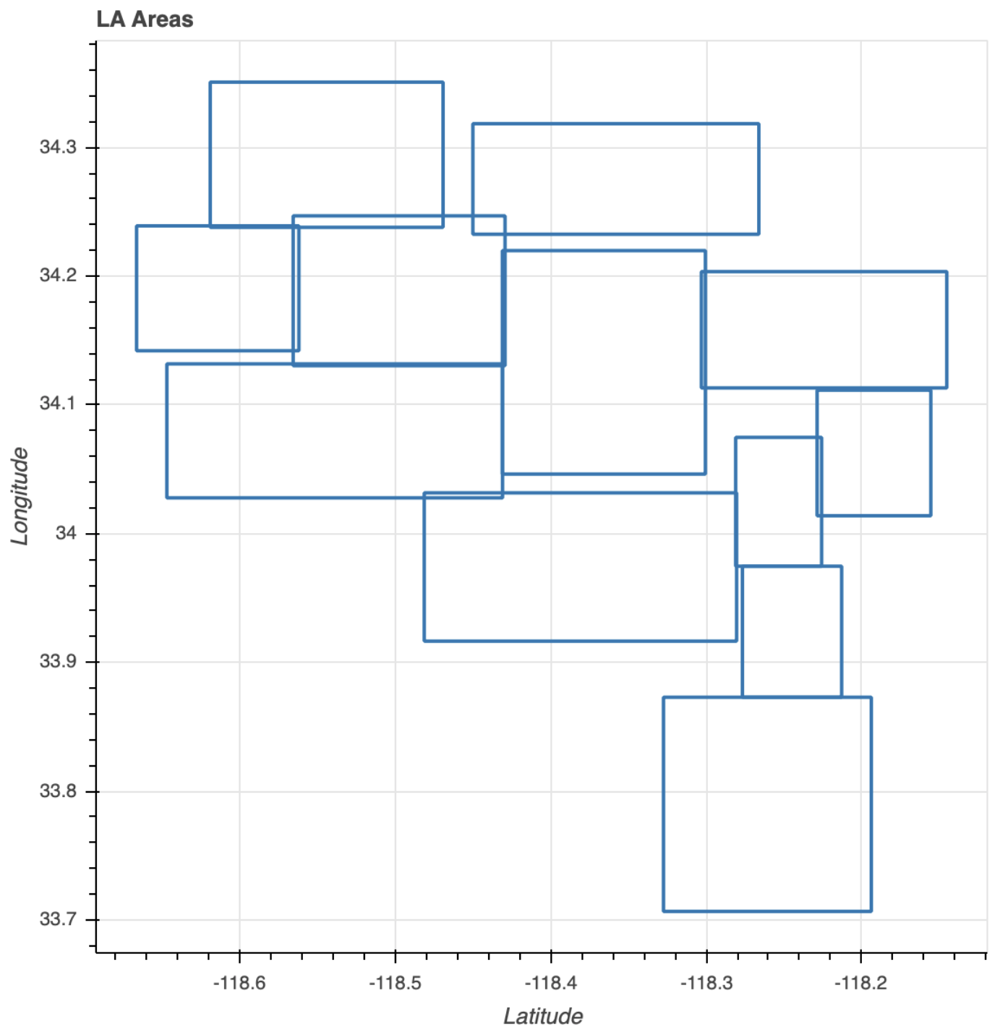
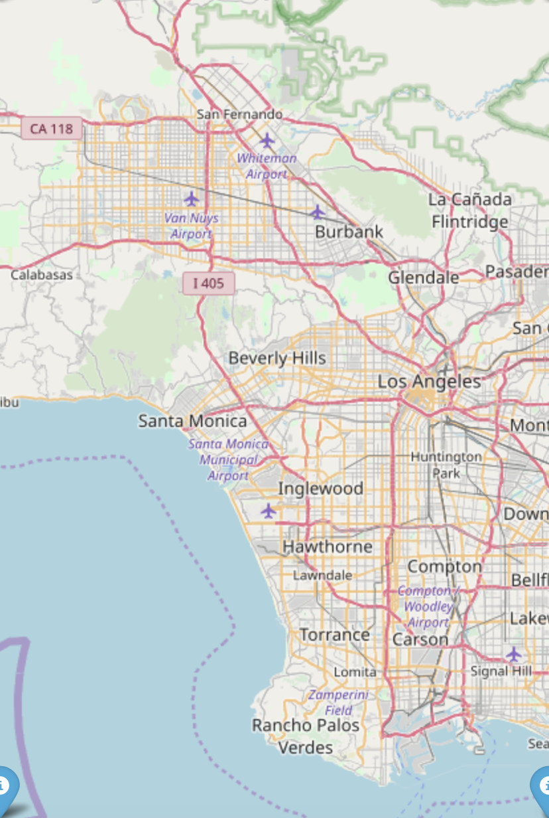
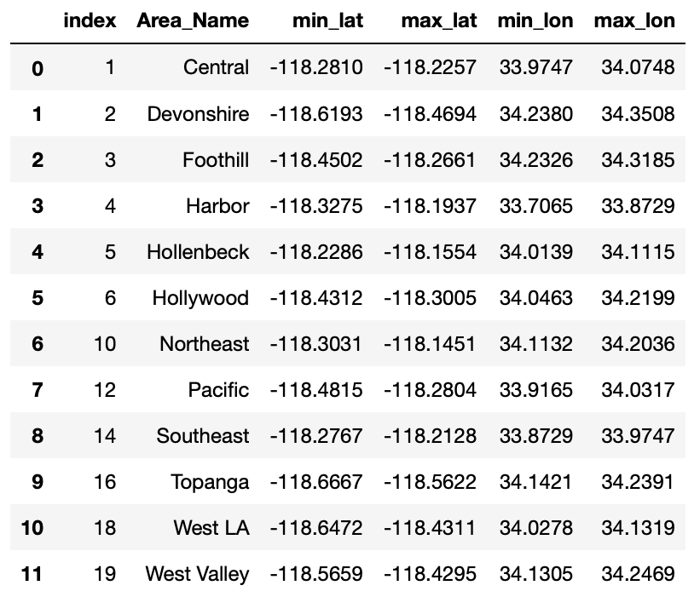
Analysis of LA areas
Divide LA into 12 popular areas
Match all the spots both in traffic and travel time datasets into those areas
Devonshire
Foothill
Topanga
West Valley
1
Northeast
Hollywood
West LA
2
Central (Los Angeles Downtown - 5)
Hollywood (Beverly Hills - 2, Universal Studios - 1)
Pacific (Santa Monica - 3, LAX International Airport - 4)
5
Hollenbeck
3
Pacific
Central
4
Southeast
Harbor

Slide 8
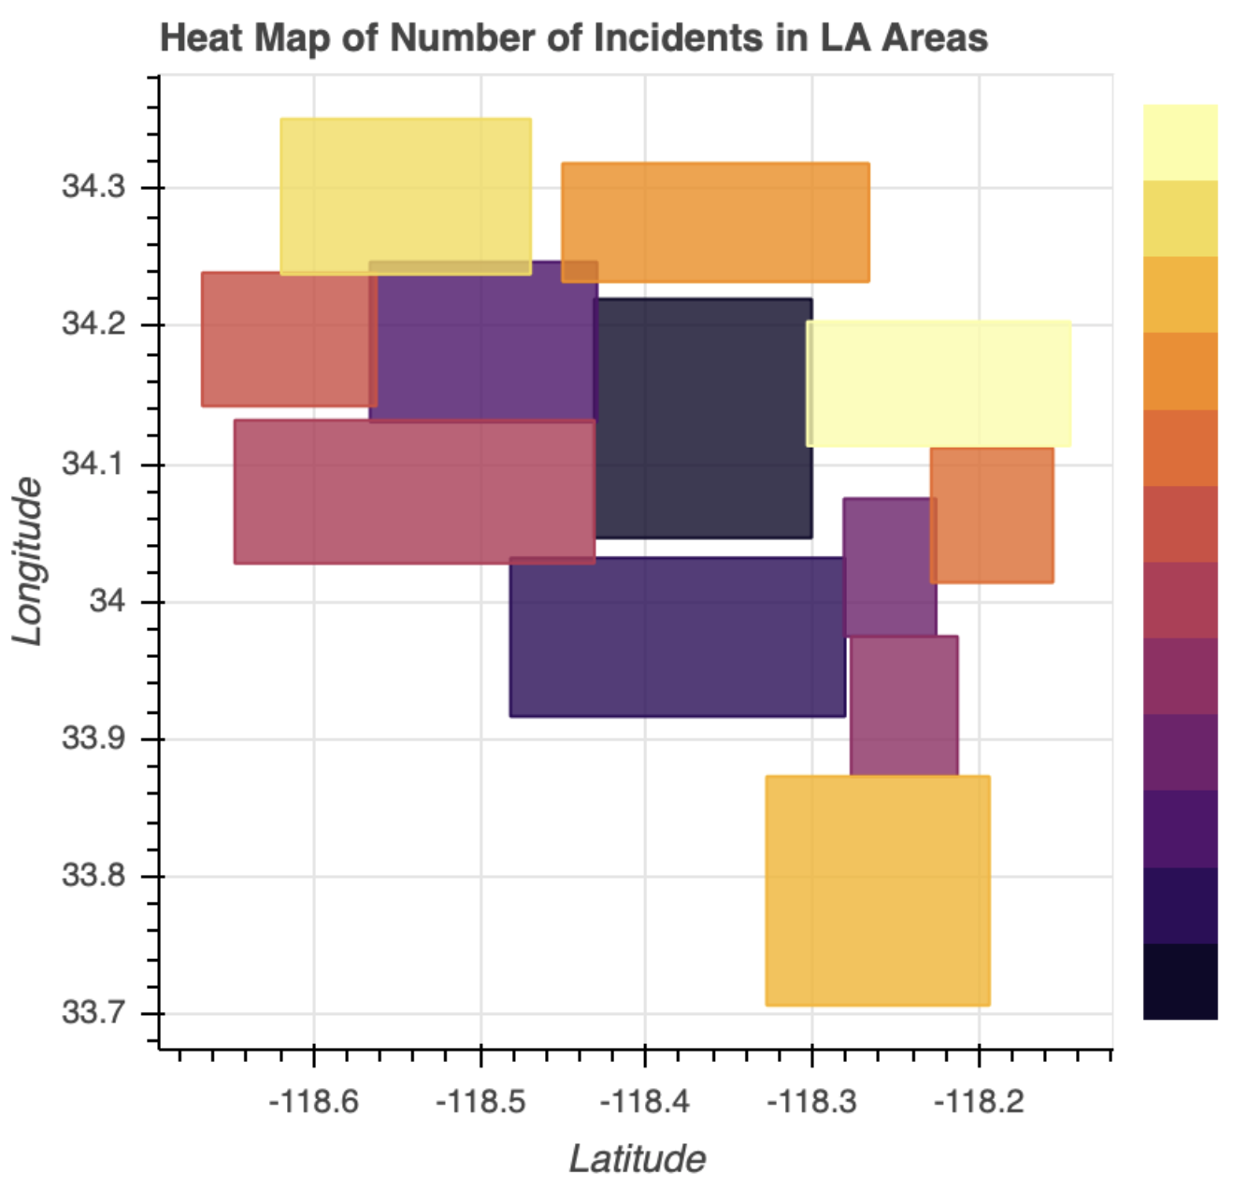
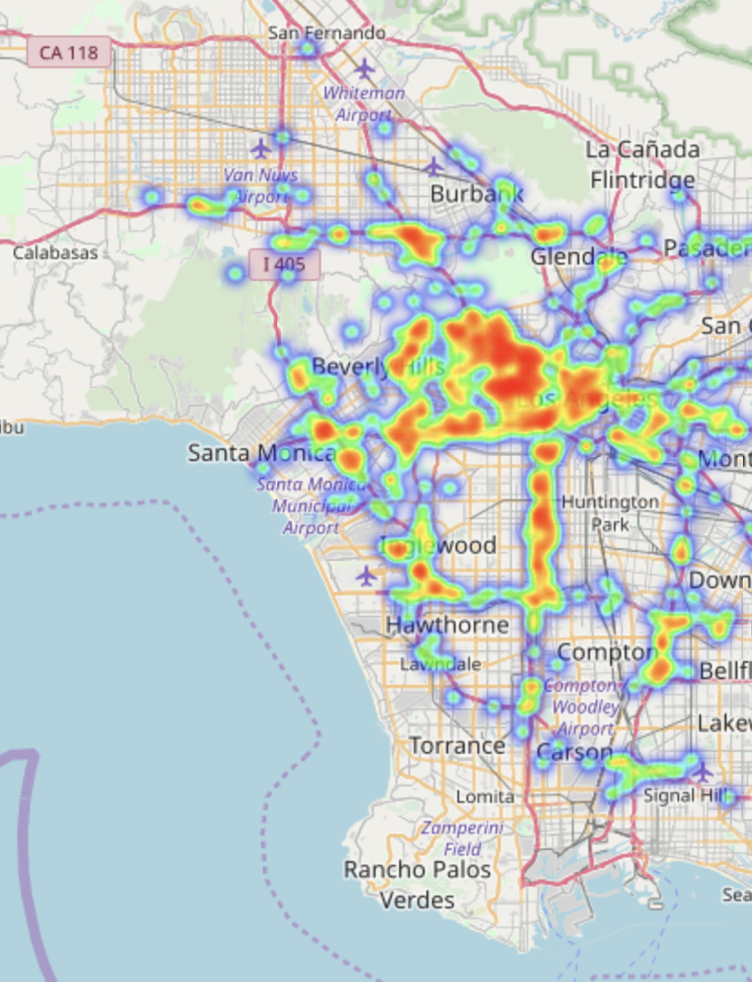
Fewer Incidents
Traffic incidents of LA areas
Central
Harbor
More
Incidents
LA Uber Ride Pick Up Distribution

Slide 9
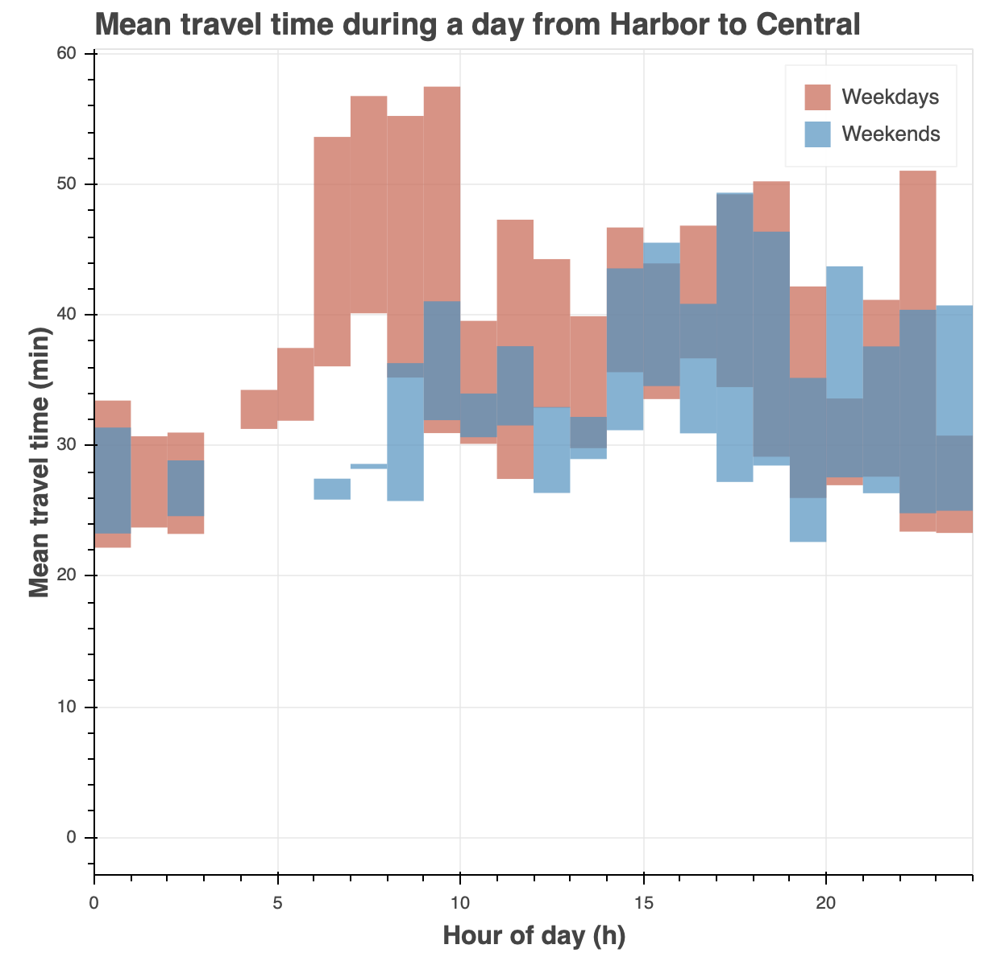
Travel times of LA areas
Weekdays:
Higher mean travel time
Morning is the rush hours
Midnight nearly has no rides
Weekends:
Lower mean travel time
Afternoon and evening are the rush hours
Midnight nearly has no rides

Slide 10
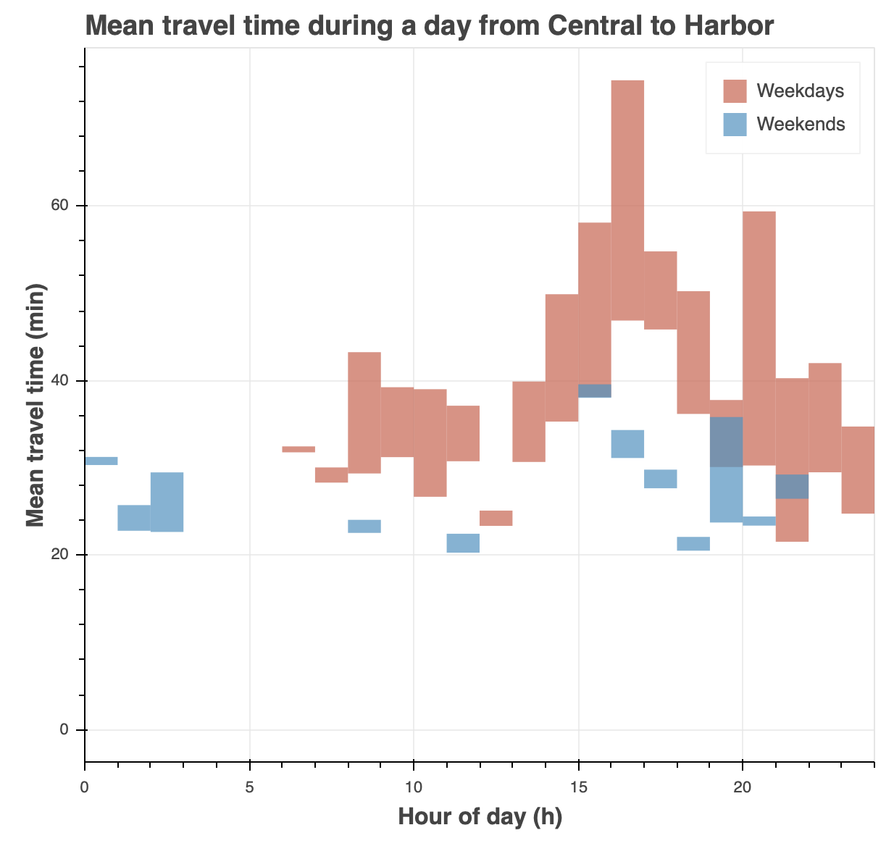
Travel times of LA areas
Higher mean travel time from Harbor to Central in the morning
Higher mean travel time from Central to Harbor during the evening
More people take rides from harbor to central during the morning and from central to Harbor during the night

Slide 11
LA Uber ride pick up distribution
Freeway I - 5
Freeway I - 405
Freeway I - 10
Freeway I - 110
Freeway I - 710

Slide 12
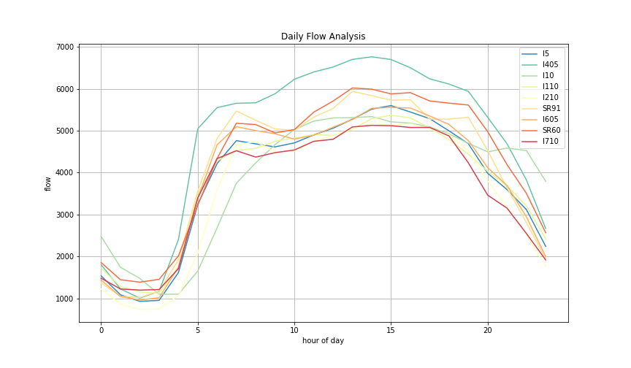

Traffic flow of LA freeways
Daily Flow Analysis
Most flow (overall): I405
More flow (nights): I10
General:
Most freeways have similar flow.
Larger flow during daytime compared to nights.
Most flow from 1pm to 6pm
Flow increases rapidly from 4am to 6am and drops after 6pm
Flow
Hour of day

Slide 13
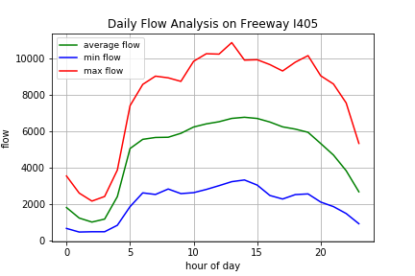
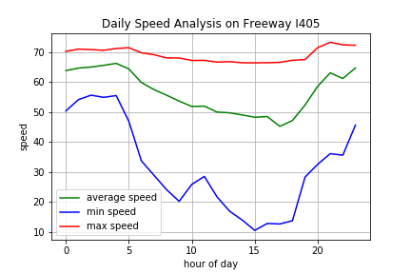
Traffic flow and speed of typical LA freeways
Flow and speed graph have inversed shapes.
Most flow during daytime. Least flow in early mornings.
Lower speed during daytime due to large flow.
Lowest speed drops rapidly due to heavy traffic in some parts of the freeway.

Slide 14
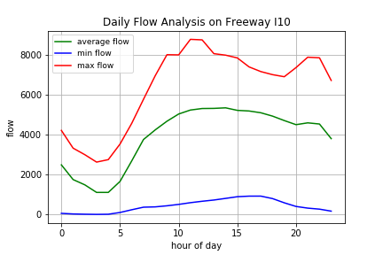
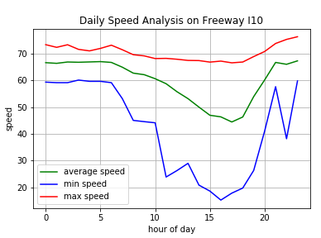
Traffic flow and speed of LA freeways
General feature stays the same.
Rapid flow drop after 11pm.
Lowest speed has another rapid drop at 11pm due to relative large flow.

Slide 15
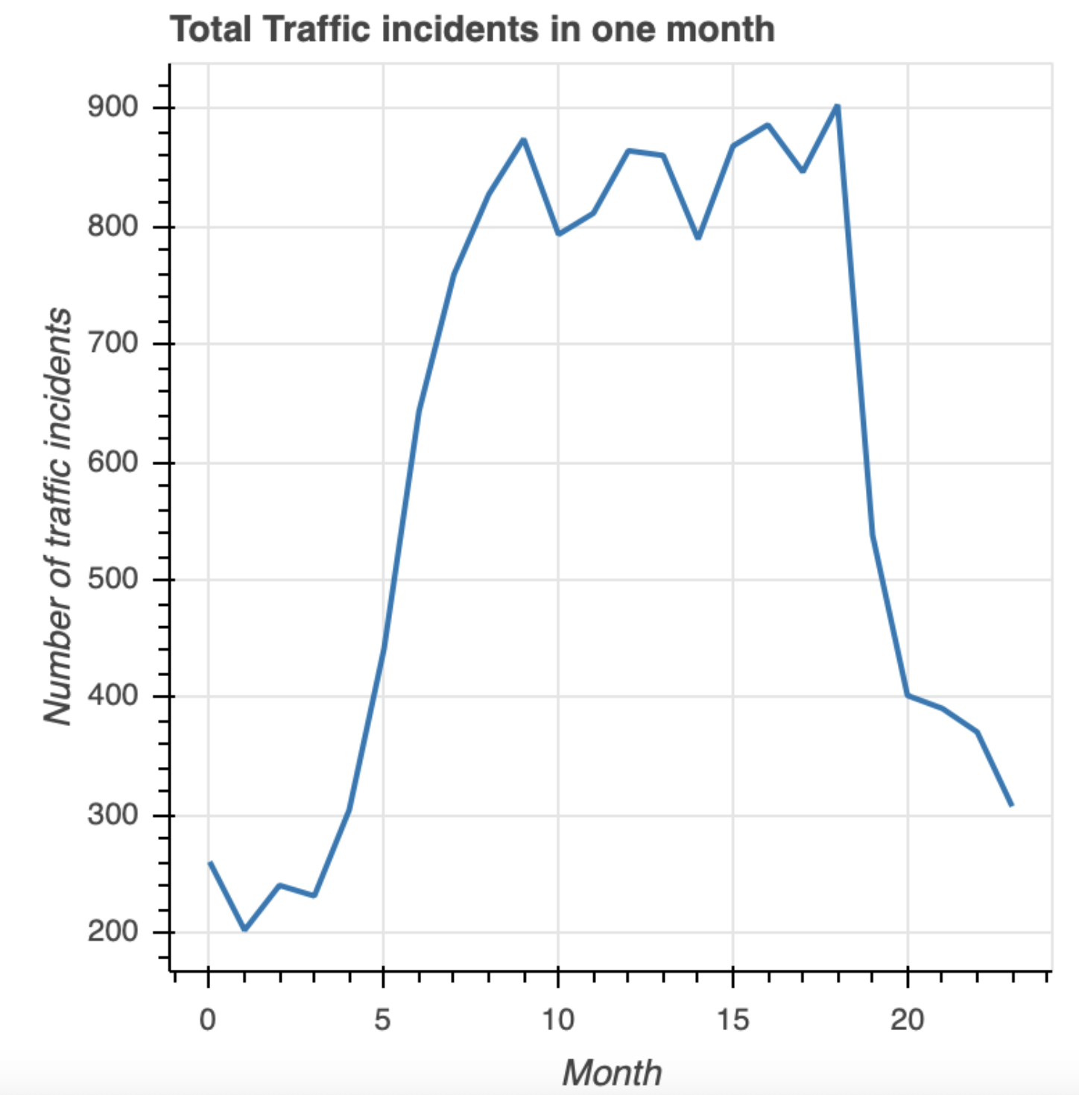
Total Traffic Incidents in One Day
Traffic incidents of LA freeways
From 5 am to 9 am, the number of incidents significantly increases
From 9 am to 6 pm, the number of incidents roughly stays the same
After 6pm, the number of incidents significantly decreases
Hour
Hours in a day

Slide 16
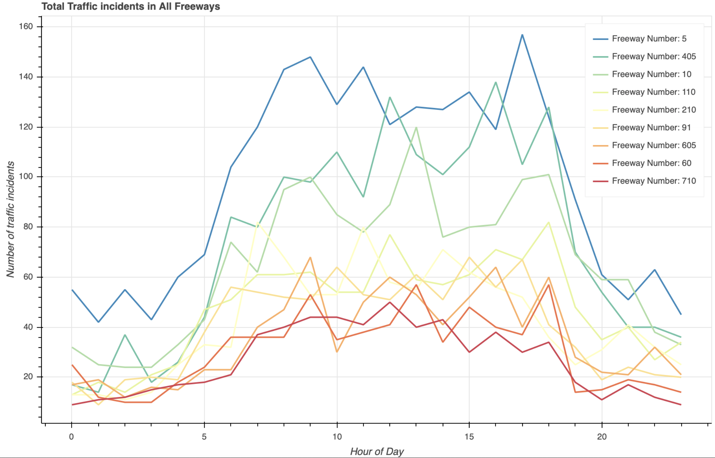
Traffic incidents of LA freeways
Most accidents:
I-5 > I-405 > I-10
Overall: similar to the trend of total incidents in a month in all freeways

Slide 17
Conclusion
By analyzing areas:
Where to pick up: Pacific (Santa Monica, LAX), Central (downtown)
When to pick up: weekdays (6 AM - 10 AM), weekends (5 PM - 12 AM)
By analyzing freeways:
Where to pick up: I110, I405 during daytime; I10 at nights

Slide 18
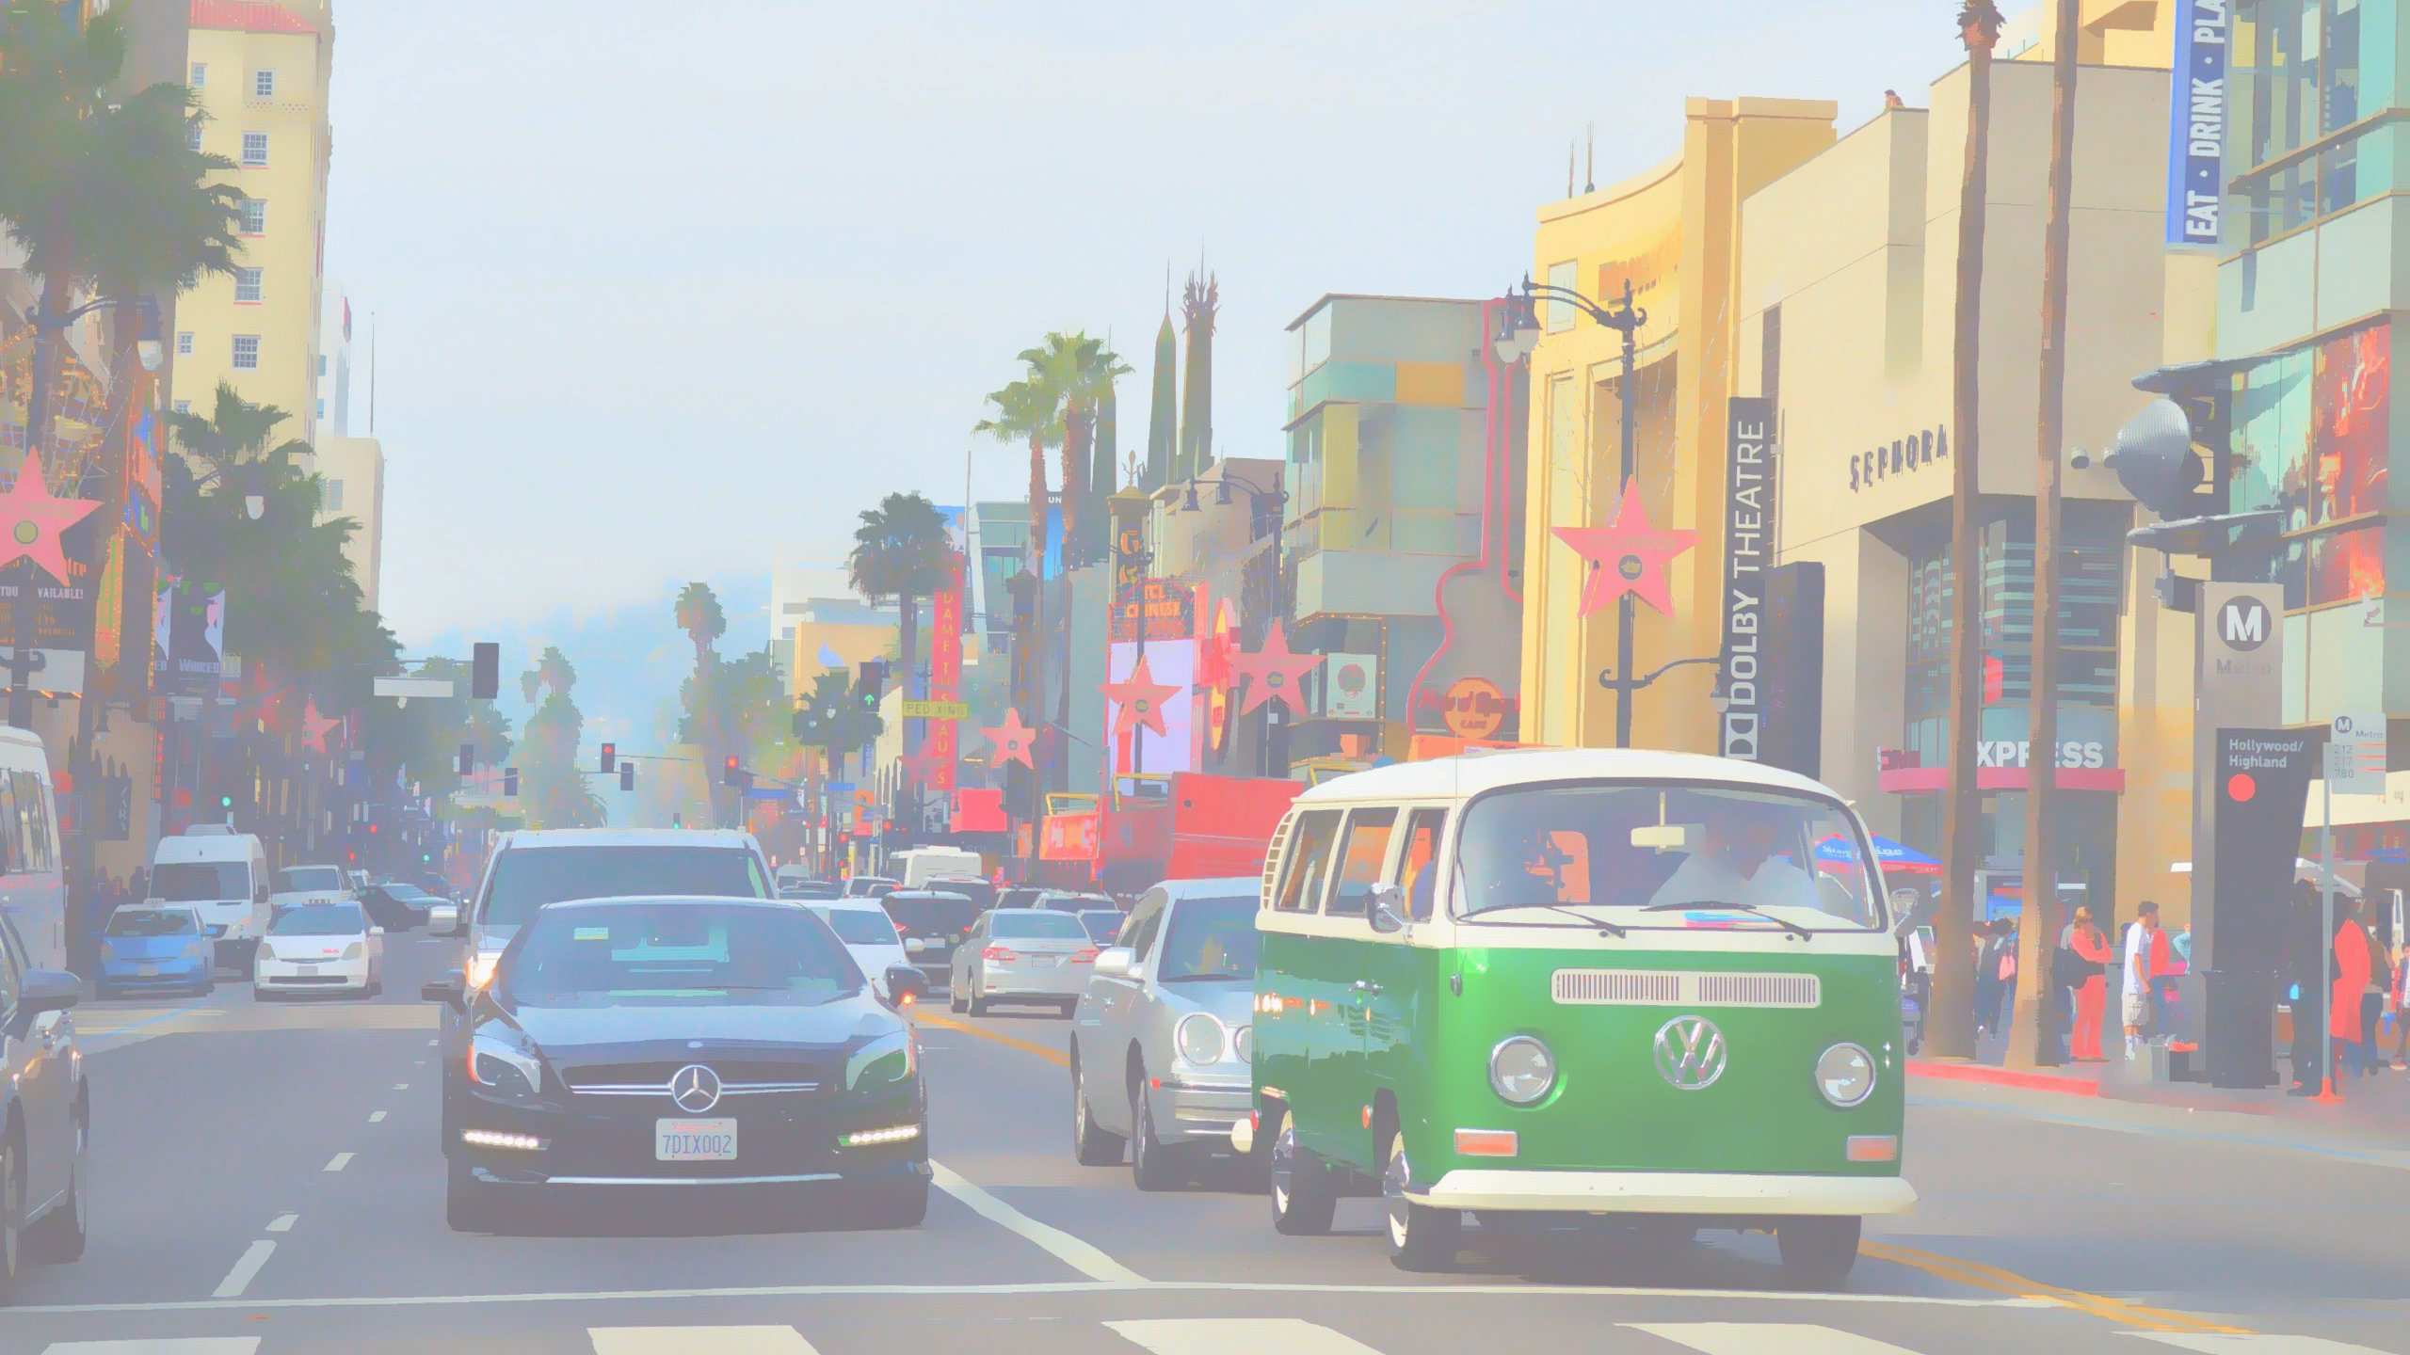
Thank you!

